Slide 1
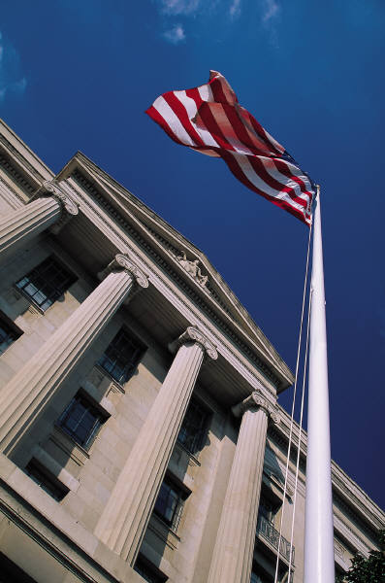
Session 3
The Legal Environment

Slide 2
Learning Objectives
Be familiar with:
Elements of DWI offenses
Provisions of implied consent
Relevance of chemical test evidence
Precedents established through case law

Slide 3
DWI Statute

Slide 4
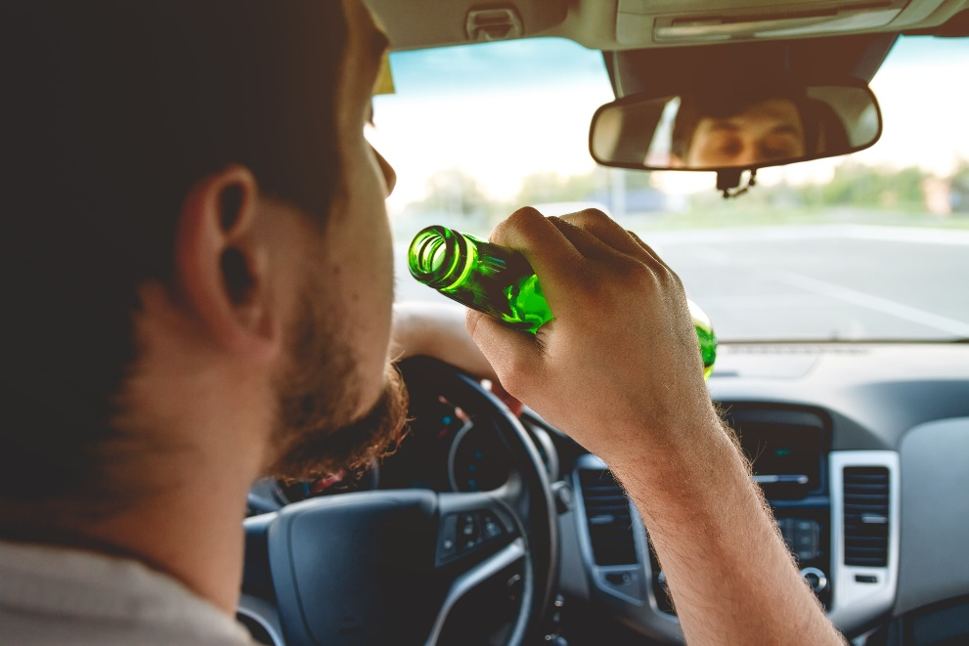
Legal Definitions
Driving
Actual Physical Control
Vehicle
Location
Impaired/Under the Influence

Slide 5
Probable Cause for DWI Arrest
Opinion based on totality of circumstances there is probable cause to believe defendant committed crime of DWI
* All elements of crime need to be present

Slide 6
Conviction
Criminal offense – establish facts
“beyond a reasonable doubt”

Slide 7
Per Se Statute
Refer to local State information

Slide 8
DWI and DWI Per Se
DWI – driving while under influence
Chemical test is additional evidence
DWI Per Se – driving while having more than a statutorily prohibited BAC
Chemical test is presumptive evidence

Slide 9
Per Se Summary
Continue to rely on your detection training and experience
Assume chemical tests will not be available
Thorough documentation is critical

Slide 10
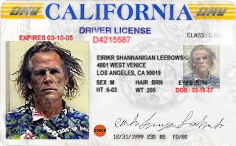
Implied Consent Law
Refer to local State information
REVOKED

Slide 11
Elements of Implied Consent
Operates or controls motor vehicle
Operator deemed to have given consent to chemical testing
Arrested for DWI
Drivers who refuse are subject to license sanctions

Slide 12
Legal Presumptions
BAC _____ or more
Presumed under the influence
Less than _____
Presumed not under the influence
At least _____ but below _____
No presumption

Slide 13
Example Number 1
Driver arrested for DWI
BAC of 0.13
Chemical test evidence introduced at trial
Arresting officer’s testimony was confusing and unclear
State unable to prove all elements beyond a reasonable doubt

Slide 14
Example Number 2
Driver arrested for DWI
BAC of 0.05
Chemical test evidence introduced at trial
Arresting officer’s testimony is clear and descriptive
Court finds defendant guilty of DWI

Slide 15
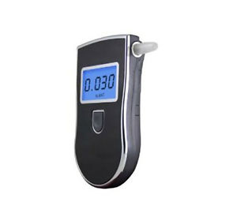
Preliminary Breath Testing (PBT)
Refer to local State information

Slide 16
Case Law Reviews
Landmark court decisions relevant to admissibility of SFSTs
Challenges may be based on:
Scientific validity and reliability
Relationship of HGN to specific BAC level
Officer training, experience, and application

Slide 17
SFST Case Law
Refer to local State information

Slide 18
Horizontal Gaze Nystagmus Case Law
Refer to local State information

Slide 19
Search and Seizure Case Law
Refer to local State information

Slide 20
Other Relevant Case Law
Refer to local State information

Slide 21
Case Law Summary

Slide 22
Test Your Knowledge
If DWI is a criminal offense, the standard of proof is _____.
The purpose of implied consent is _____.
For the Per Se offense, chemical test result is _____ evidence.
The Per Se law makes it unlawful to _____.

